Slide 1
The African language in the classroom:
What happens when children’s home languages are used in education?
Agatha van Ginkel, SIL International
Notes:
This paper focuses on the use of children’s home language in formal education in sub-Saharan Africa. In many countries in Africa children of minority language groups are disadvantaged because they receive their education through a language of wider communication which they do not understand. Several countries in Africa have adopted a language policy for education that favours mother tongue based multilingual education. Children receive education in their home language and during the course of their school careers they are transitioned to the language of wider communication. These language policies have been implemented with different rates of success. When implemented well, this kind of language policy is indeed enhancing inclusive education, learning outcomes are higher, fewer children have to repeat classes and there are fewer drop outs. This paper examines and evaluates the implementation of multilingual language policies of several African countries. It will show that a successful inclusion of the use of the African languages in Africa needs to address issues such as: development and distribution of educational materials in the first language, teacher training, teacher placement, attitude of teachers and community towards mother tongue based multilingual education, the political will to implement the language policy, and the development of fair assessment tools to measure learning outcomes in multilingual contexts.

Slide 2
My link with Africa
Since 1995 in Africa
SIL International Africa Area Office (based in Nairobi)
I have specialised in
reading in different languages in particular African language
transfer reading (L2-L1 and L1 – L2)
Multilingual Education

Slide 3
Terminology L1
L1 first language
mother tongue
home language
language of the home
local language
national language
Indigenous language
The language a child speaks best before she/he comes to school.
Notes:
What it is not:
It does not equal the ethnic group one comes from.
For example: In Nairobi in Kenya there are Kikuyu children who speak English and Sheng. But they do not speak Kikuyu.
While they belong to the ethnic group Kikuyu their first language is not Kikuyu, it has become English.

Slide 4
Terminology L2
L2 second language
a language one learns in addition to the L1.
English as Second Language
(it is used in the immediate environment)
English as Foreign Language
(it is not a language used in the immediate environment)

Slide 5
The current situation in Africa

Slide 6
The reality
In Africa there are about 2000 languages.
However, about 800 of them have a writing system.

Slide 7
The reality
The colonial languages English, French and Portuguese have taken a very high status position.
However, it is estimated that only between 10 and 15 per cent of the population in most African countries are fluent in the official languages (En/Fr/Port) (Ouane and Glanz 2010).

Slide 8
The reality
In many countries in Africa education is delivered in a language children do not understand. (Unlike Europe, UK and USA)
From the first day in school, the children are exposed to the new language and their mother tongue is not used in school.

Slide 9
The reality in school
The reality is that the children do not understand the teacher until several years into their education.
Consequently, most children in Africa find themselves having to try to learn through a language they do not understand.
Many of them fail and drop out before they learn any content. Many are excluded.

Slide 10
Research Results

Slide 11
Data from Kenya Early Grade Reading Assessment Findings Report (Piper 2010)
Notes:
If not well implemented these are the results (after two years of primary education). An early exit policy is in place but it is not implemented.

Slide 12
L1 vs L2 instruction
Cameroon, Kom L1 based bilingual programme (Walter and Tremmel 2010)
Notes:
A transitional programme in Cameroon there is an example of what it could look like if the policy is implemented. Look at the reading scores.

Slide 13
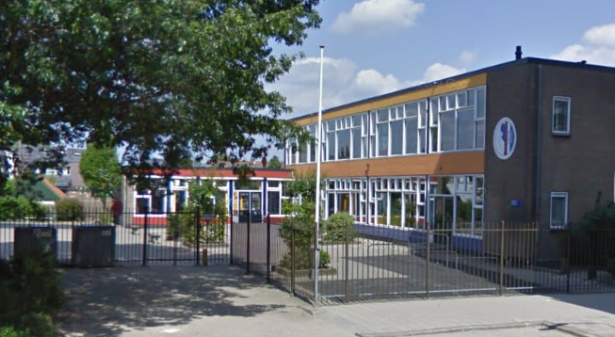
Equal comprehension scores in Africa and Europe?
Netherlands, reading in L1

Slide 14
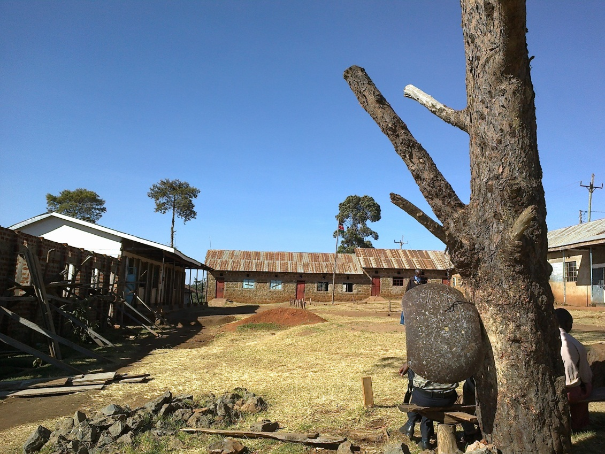
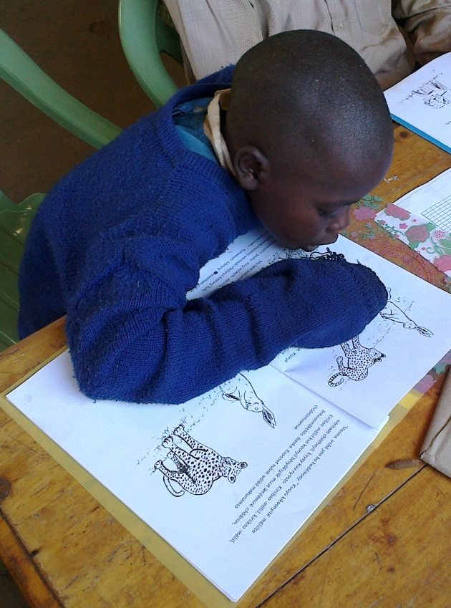
Sabaot (Kenya) reading in L1

Slide 15
Comprehension scores
Netherlands and Sabaot in Kenya, (Van Ginkel and Graham, in preparation 2012)
Notes:
Example of reading comprehension in the mother tongue. The scores of children in remote area in Kenya are comparable to scores of children in the Netherlands.

Slide 16
Do children learn English well when the L1 is used a MOI?
Cameroon, Kom L1 based bilingual programme (Walter and Tremmel 2010)

Slide 17
What are the issues?

Slide 18
Teacher training
Teacher placement
Attitude of stakeholders
Materials development
Materials distribution
Expanding vocabulary of a language to non-cultural domains (snow, pigs, rectangle)
Testing

Slide 19
After two years of Primary School
Children can have learnt:
the basic skills of reading.
to read at a fluent pace and comprehend what they are reading.
The pace (in words per minute) is different for different languages. (Important to remember).

Slide 20
Five important components (NRP-USA)
Recognise sounds in words
Connect sounds and letters
Read at a good pace
Understand what is read
Have sufficient vocabulary
Phonological awareness
Alphabetic principle
Fluency
Comprehension
Vocabulary
Notes:
No 1 -3 are critical for automatic word recognition
No 4 and 5 are critical for comprehension.

Slide 21
Reading fluency - WPM
Each language its own criteria
He is searching for his pen.
Keecheeng’oote kalamuunyii.

Slide 22
Reading Comprehension linked to wpm
Language | Comprehension | Word per minute
Gikuyu | 80% | 40
Dholuo | 80% | 55
Kiswahili | 80% | 60
Amharic | 80% | 54
Somali | 80% | 56
English | 80% | 92

Slide 23
Languages of Wider World
Important in native and non-native settings
Large educational benefits using African Languages in Education.
Ideological reasons: identity, culture, morals and values.
Planning and political will
Good Research

Slide 24
Asante sana

